Slide 1

Deep Learning Basics
汤斯亮（Siliang Tang）
siliang@zju.edu.cn

Slide 2
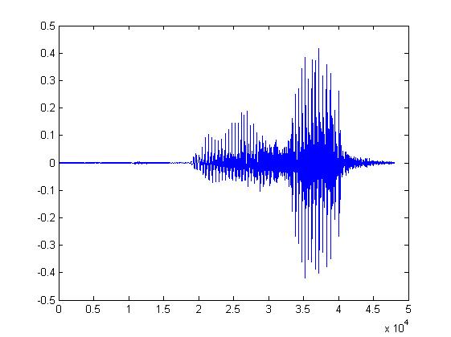

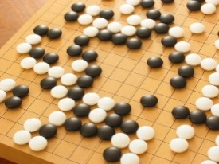
Machine Learning ≈ Looking for a Function
Speech Recognition
Image Recognition
Playing Go
Dialogue System
“How are you”
“Cat”
“5-5”
(next move)
“Hi”
“Hello”
(what the user said)
(system response)

Slide 3
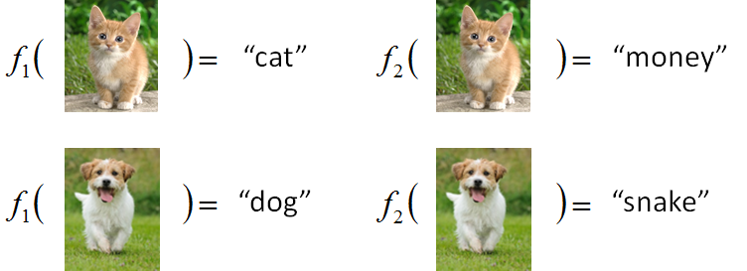



Framework
Image Recognition:
“cat”
A set of function
Model
Better!
Goodness of function f
Supervised Learning
function input:
Training
Data
function output:
“monkey”
“cat”
“dog”

Slide 4
Framework
Image Recognition:
“cat”
A set of function
Model
Training
Testing
“cat”
Step 1
Goodness of function f
Pick the “Best” Function
Using
Step 2
Step 3
Training
Data
“monkey”
“cat”
“dog”

Slide 5
Three Steps for Deep Learning
Step 1: define a set of function
Step 2: goodness of function
Step 3: pick the best function
Neural Network

Slide 6

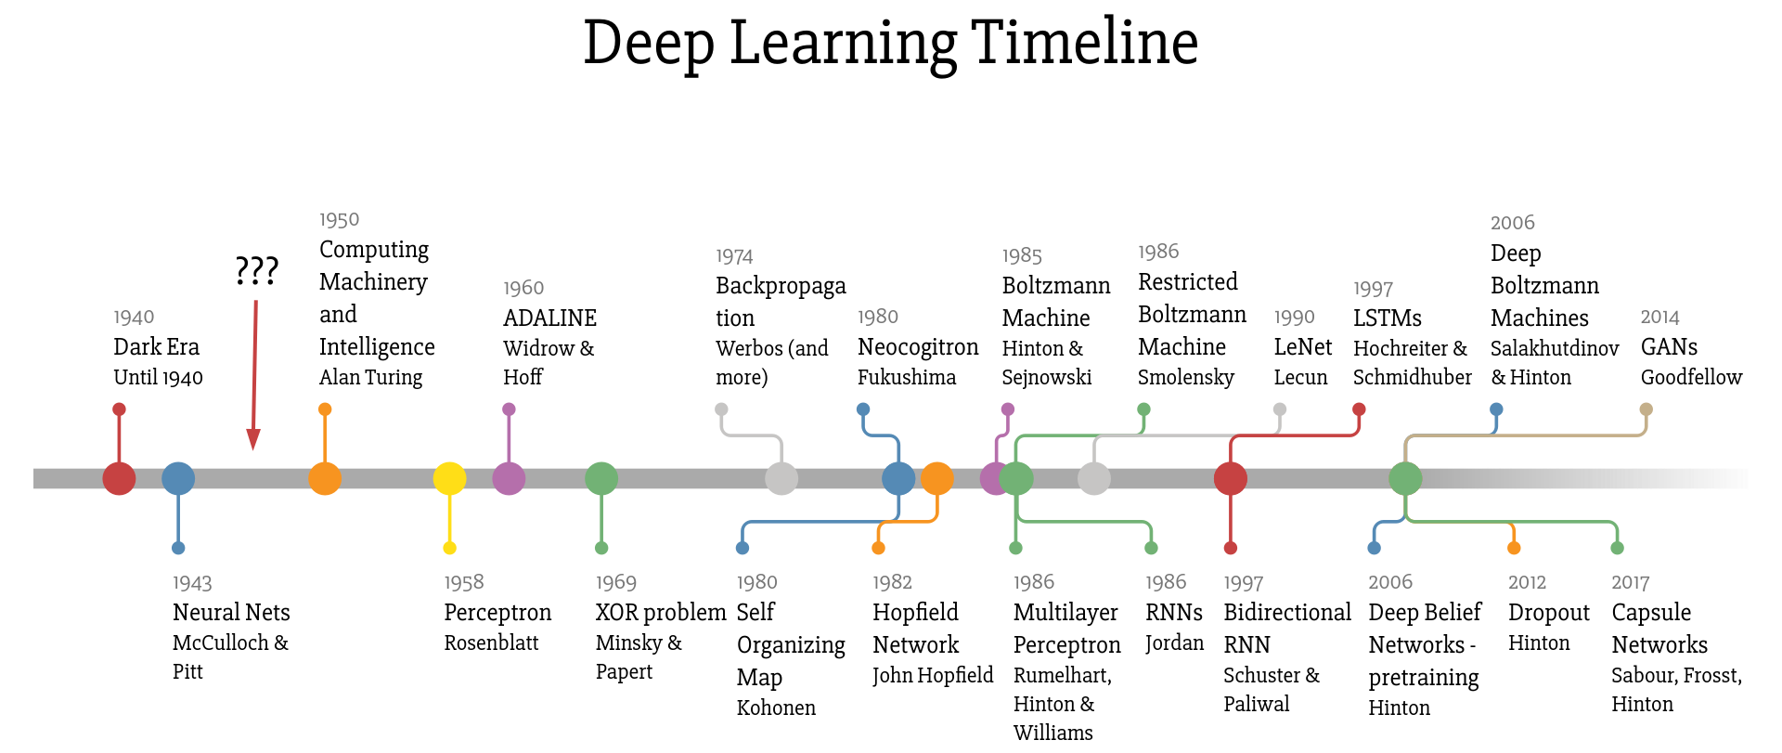
Deep Learning

Slide 7
Neural Network
Neuron
A simple function
…
…
…
…
Activation function
weights
bias

Slide 8
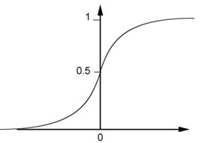
Neural Network
Neuron
Sigmoid Function
2
1
4
-1
-2
0.98
Activation function
-1
1
weights
1
bias

Slide 9
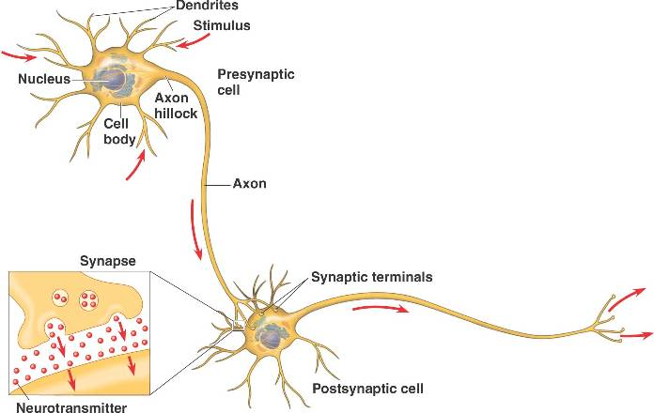
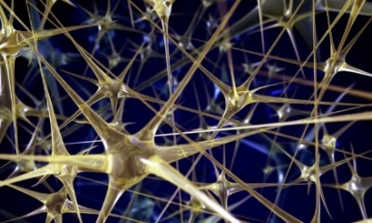

Neural Network
Different connections lead to different network structures
The neurons have different values of weights and biases.
Weights and biases are network parameters $θ$

Slide 10
Fully Connect Feedforward Network
1
4
0.98
1
-2
1
-1
-2
0.12
-1
1
0
Sigmoid Function

Slide 11
Fully Connect Feedforward Network
1
4
0.98
2
0.86
3
0.62
1
-2
-1
-1
1
0
-2
-1
-2
0.12
-2
0.11
-1
0.83
-1
1
-1
4
0
0
2

Slide 12
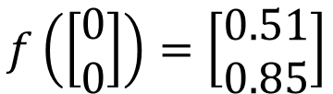
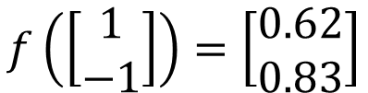

Fully Connect Feedforward Network
1
0.73
2
0.72
3
0.51
0
-2
-1
-1
1
0
-2
-1
0.5
-2
0.12
-1
0.85
0
1
-1
4
0
0
2
This is a function.
$$f\left(\left[\begin{matrix}1 \\ −1\end{matrix}\right]\right)=\left[\begin{matrix}0.62 \\ 0.83\end{matrix}\right]$$
$$f\left(\left[\begin{matrix}0 \\ 0\end{matrix}\right]\right)=\left[\begin{matrix}0.51 \\ 0.85\end{matrix}\right]$$
Input vector, output vector
Given parameters $θ$, define a function
Given network structure, define a function set

Slide 13
Fully Connect Feedforward Network
neuron
Input
Layer 1
Layer 2
Layer L
Output
……
y₁
……
y₂
……
……
……
……
……
……
y_{M}
Input Layer
Output Layer
Hidden Layers
Deep means many hidden layers

Slide 14
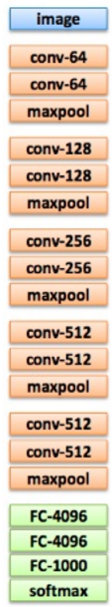
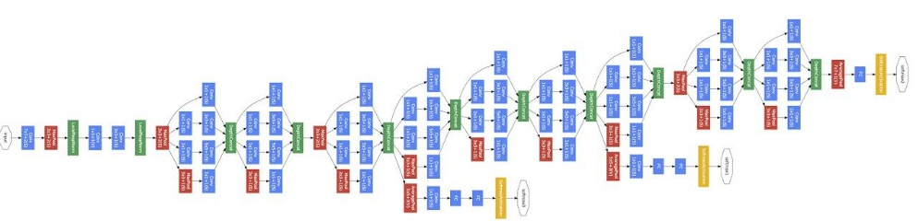
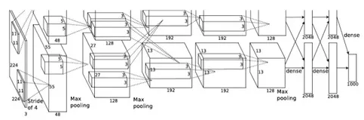
Deep = Many hidden layers
22 layers
http://cs231n.stanford.edu/slides/winter1516_lecture8.pdf
19 layers
8 layers
6.7%
7.3%
16.4%
AlexNet (2012)
VGG (2014)
GoogleNet (2014)

Slide 15
Deep = Many hidden layers
152 layers
Special
structure
3.57%
7.3%
6.7%
16.4%
Residual Net
(2015)
AlexNet (2012)
VGG
(2014)
GoogleNet
(2014)

Slide 16

Why we need deep?
$$≈$$
Shallow & wide
the same number of parameters
Deep & Narrow
Less pieces
More pieces

Slide 17
Fully Connect Feedforward Network
neuron
Input
Layer 1
Layer 2
Layer L
Output
……
y₁
……
y₂
……
……
……
……
……
……
y_{M}
Input Layer
Output Layer
Hidden Layers

Slide 18
Output Layer
Softmax layer as the output layer
Ordinary Layer
In general, the output of network can be any value.
May not be easy to interpret

Slide 19
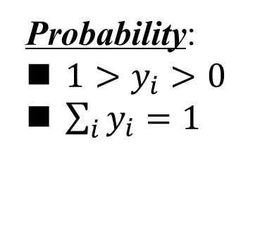
Output Layer
Probability:
$1>y_{i}>0$
$\sum_{i}{y_{i}=1}$
Softmax layer as the output layer
Softmax Layer
3
20
0.88
1
2.7
0.12
-3
0.05
≈0

Slide 20
Three Steps for Deep Learning
Step 1: define a set of function
Step 2: goodness of function
Step 3: pick the best function

Slide 21








Training Data
Preparing training data: images and their labels
“5”
“0”
“4”
“1”
“9”
“2”
“1”
“3”
The learning target is defined on the training data.

Slide 22
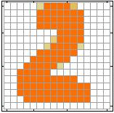


Learning Target
……
y₁
is 1
……
y₂
Softmax
is 2
……
……
……
……
y₁₀
is 0
16 x 16 = 256
Ink → 1
No ink → 0
The learning target is ……
Input:
y₁ has the maximum value
Input:
y₂ has the maximum value

Slide 23
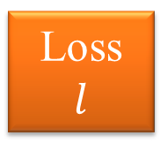
Loss
A good function should make the loss of all examples as small as possible.
“1”
……
y₁
1
As close as possible
……
y₂
Given a set of parameters
0
Softmax
……
……
……
……
……
Loss
$$l$$
……
y₁₀
0
Loss can be square error or cross entropy between the network output and target
target

Slide 24


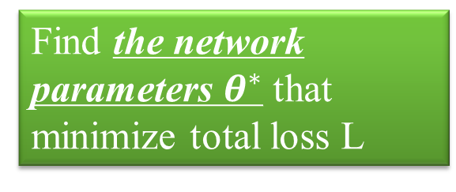









Total Loss
Total Loss:
$$L=\sum_{r=1}^{R}{l_{r}}$$
For all training data …
x¹
NN
y¹
$${\hat{y}}^{1}$$
$$l_{1}$$
As small as possible
x²
NN
y²
$${\hat{y}}^{2}$$
Find a function in function set that minimizes total loss L
$$l_{2}$$
x³
NN
y³
$${\hat{y}}^{3}$$
$$l_{3}$$
……
……
……
……
Find the network parameters $θ^{∗}$ that minimize total loss L
x^{R}
NN
y^{R}
$${\hat{y}}^{R}$$
$$l_{R}$$

Slide 25
Three Steps for Deep Learning
Step 1: define a set of function
Step 2: goodness of function
Step 3: pick the best function

Slide 26

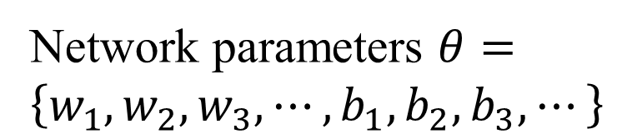
How to pick the best function
Find network parameters $θ^{∗}$ that minimize total loss L
Layer l
Layer l+1
Enumerate all possible values
Network parameters $θ=\left\{w_{1},w_{2},w_{3},⋯,b_{1},b_{2},b_{3},⋯\right\}$
10⁶
weights
……
……
Millions of parameters
E.g. speech recognition: 8 layers and 1000 neurons each layer
1000
neurons
1000
neurons

Slide 27
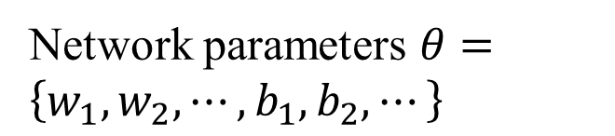
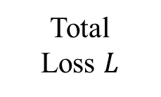
Gradient Descent
Network parameters $θ=\left\{w_{1},w_{2},⋯,b_{1},b_{2},⋯\right\}$
Find network parameters $θ^{∗}$ that minimize total loss L
Pick an initial value for w
Total
Loss $L$
Random, RBM pre-train
Usually good enough

Slide 28

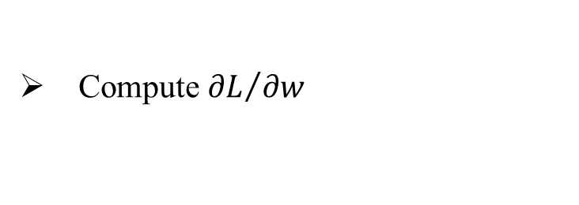
Gradient Descent
Network parameters $θ=\left\{w_{1},w_{2},⋯,b_{1},b_{2},⋯\right\}$
Find network parameters $θ^{∗}$ that minimize total loss L
Pick an initial value for w
Total
Loss $L$
Compute ${∂L}/{∂w}$
Negative
Increase w
Positive
Decrease w

Slide 29
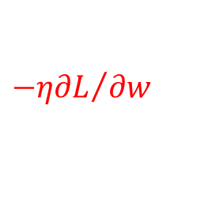
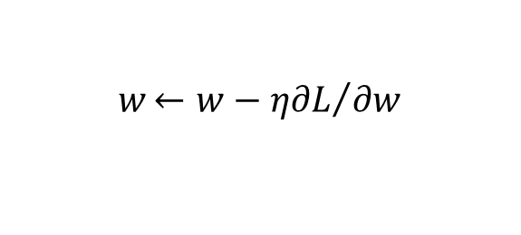
Gradient Descent
Network parameters $θ=\left\{w_{1},w_{2},⋯,b_{1},b_{2},⋯\right\}$
Find network parameters $θ^{∗}$ that minimize total loss L
Pick an initial value for w
Total
Loss $L$
Compute ${∂L}/{∂w}$
$$w{←w−η∂L}/{∂w}$$
Repeat
η is called “learning rate”
$${−η∂L}/{∂w}$$

Slide 30
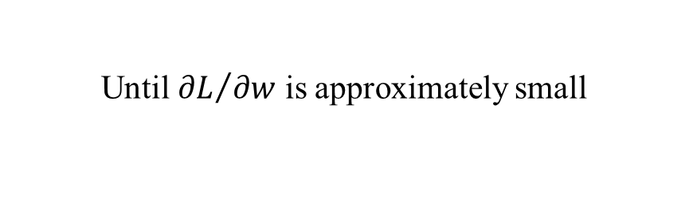
Gradient Descent
Network parameters $θ=\left\{w_{1},w_{2},⋯,b_{1},b_{2},⋯\right\}$
Find network parameters $θ^{∗}$ that minimize total loss L
Pick an initial value for w
Total
Loss $L$
Compute ${∂L}/{∂w}$
$$w{←w−η∂L}/{∂w}$$
Repeat
Until ${∂L}/{∂w}$ is approximately small
(when update is little)

Slide 31
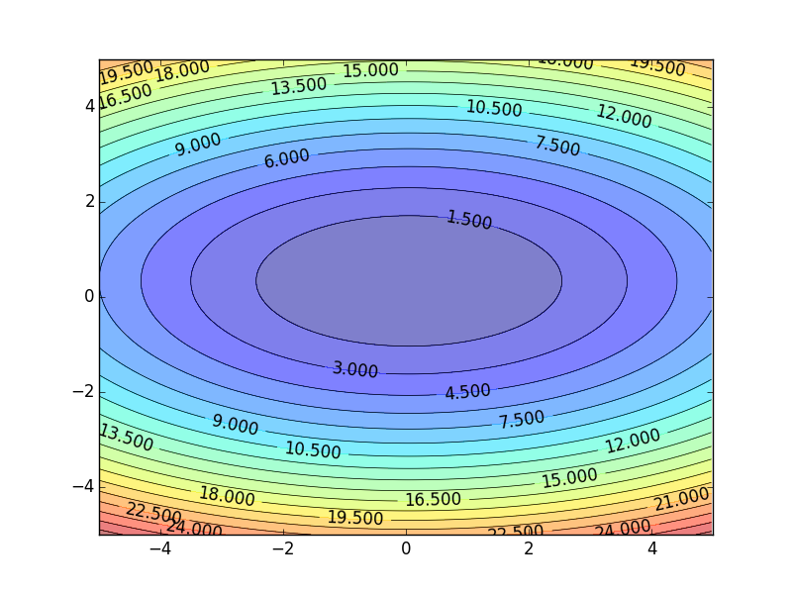
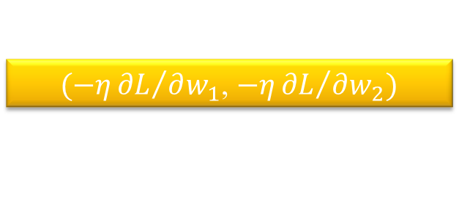
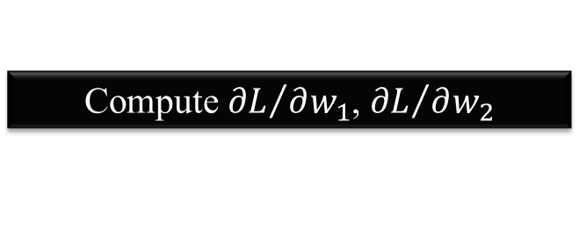


Gradient Descent
Hopfully, we would reach a minima …..
Color: Value of Total Loss L
$$w_{2}$$
$(−η{∂L}/{∂w_{1}}$, $−η{∂L}/{∂w_{2}})$
Compute ${∂L}/{∂w_{1}}$, ${∂L}/{∂w_{2}}$
$$w_{1}$$

Slide 32
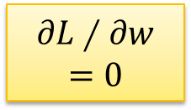
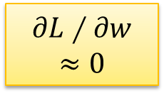

Local Minima
Total
Loss
Very slow at the plateau
Stuck at saddle point
Stuck at local minima
$$∂L∕∂w$$
$$≈0$$
$$∂L∕∂w$$
$$=0$$
$$∂L∕∂w$$
$$=0$$
The value of a network parameter w

Slide 33
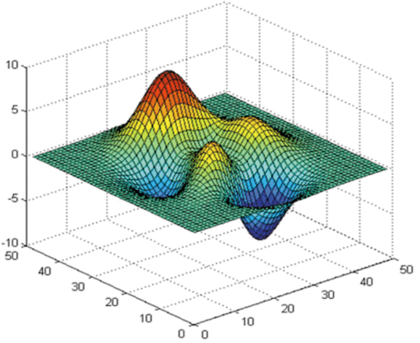



Local Minima
Gradient descent never guarantee global minima
Different initial point
$$L$$
Reach different minima, so different results
$$w_{1}$$
$$w_{2}$$

Slide 34


Gradient Descent
This is the “learning” of machines in deep learning ……
Even alpha go using this approach.
People image ……
Actually …..
I hope you are not too disappointed :p

Slide 35






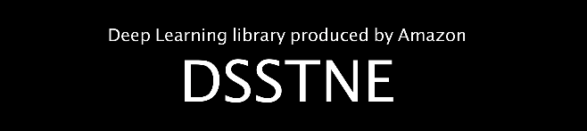

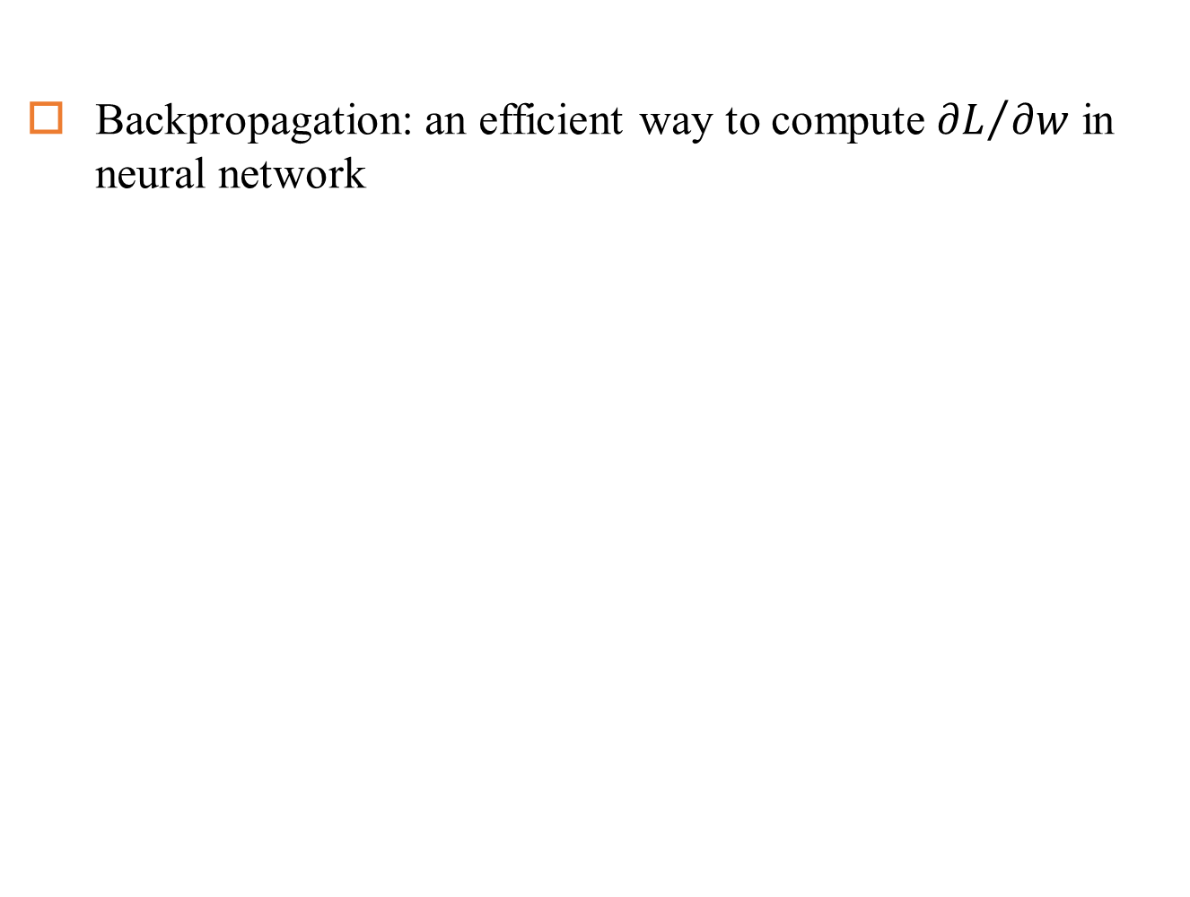
Backpropagation
Backpropagation: an efficient way to compute ${∂L}/{∂w}$ in neural network

Slide 36
Any Questions?

